Slide 1
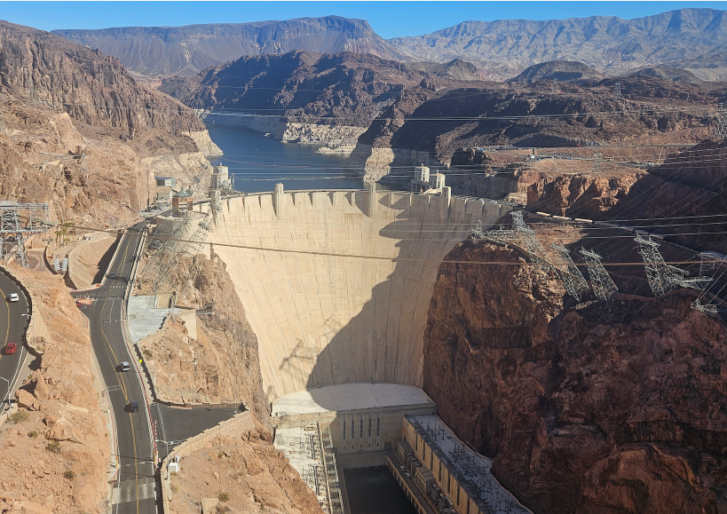
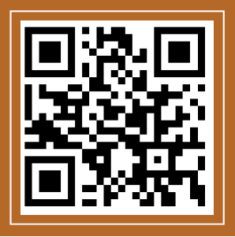




Help Improve NOAA Tools to Manage Risks of Water Shortages?
Adapt strategies for low storage and volatile, low flow.
Give users more autonomy and flexibility to manage their differing interests.
Join an immersive online collaborative model session.
Fun
Friendly
2-hour time commitment
No prior modeling experience needed.
CONTACT
Caitlyn Andrus: a02312721@usu.edu 805-8351742
Brittany Fager: Brittany.fager@usu.edu 850-200-7040
David Rosenberg: david.rosenberg@usu.edu,
435-797-8689
Project #IRB-14808
OUR RECENT WORK
rosenberg.usu.edu

